Slide 1
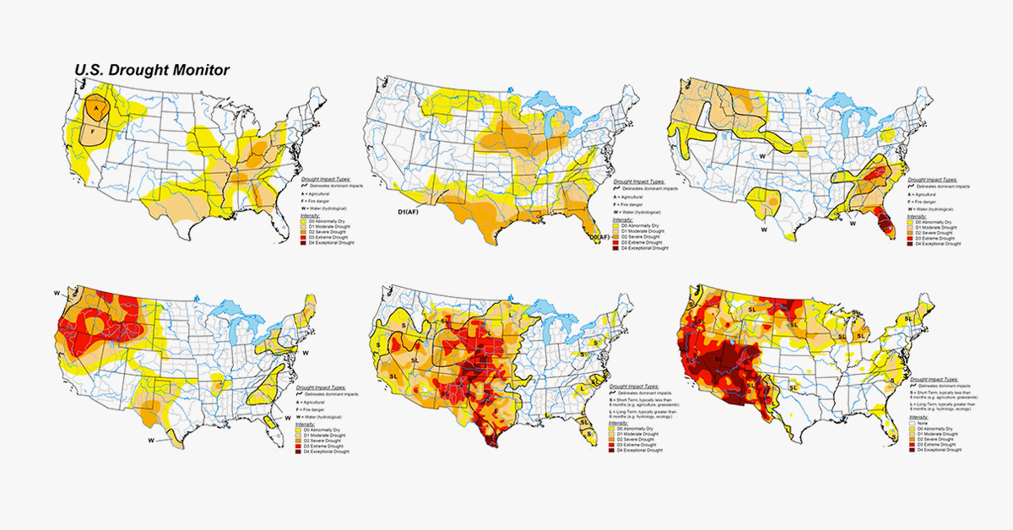
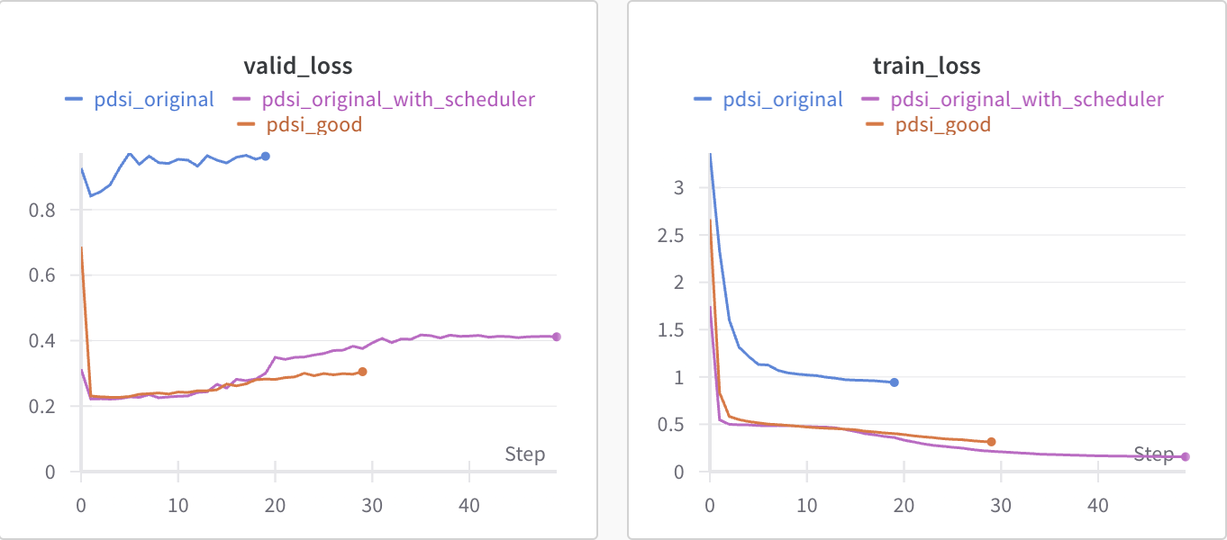
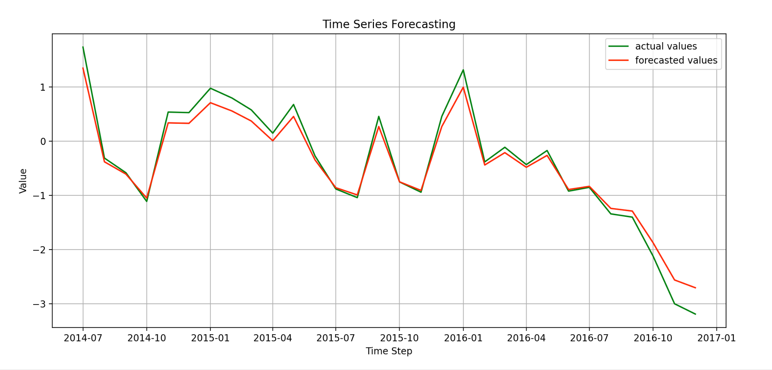
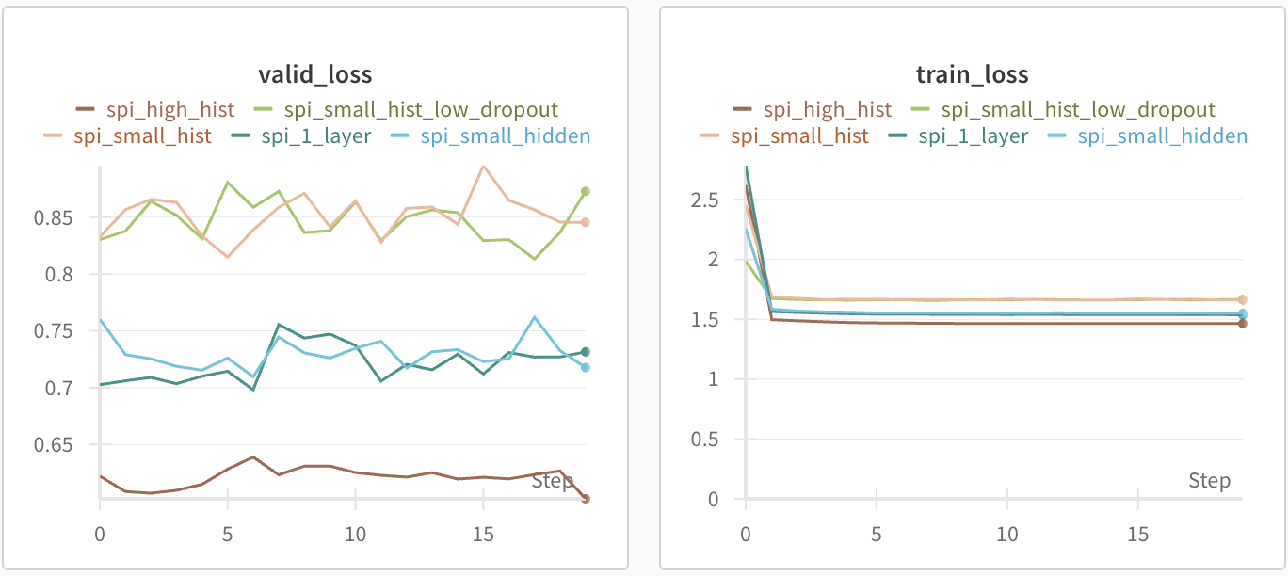
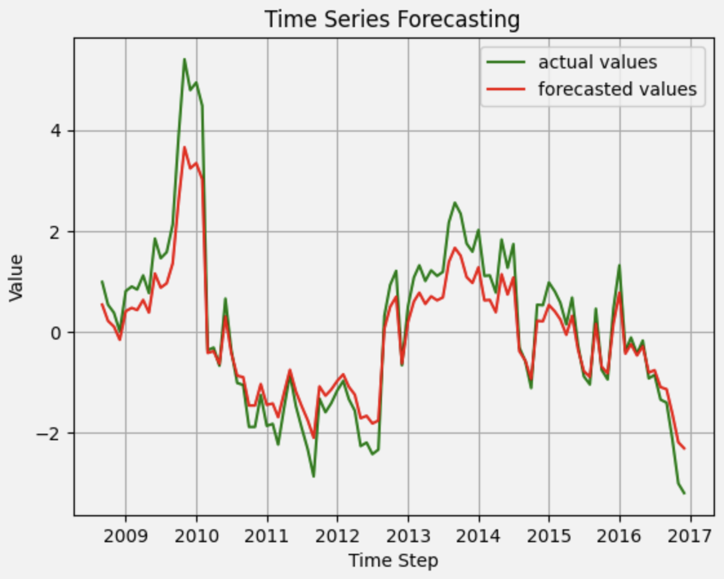
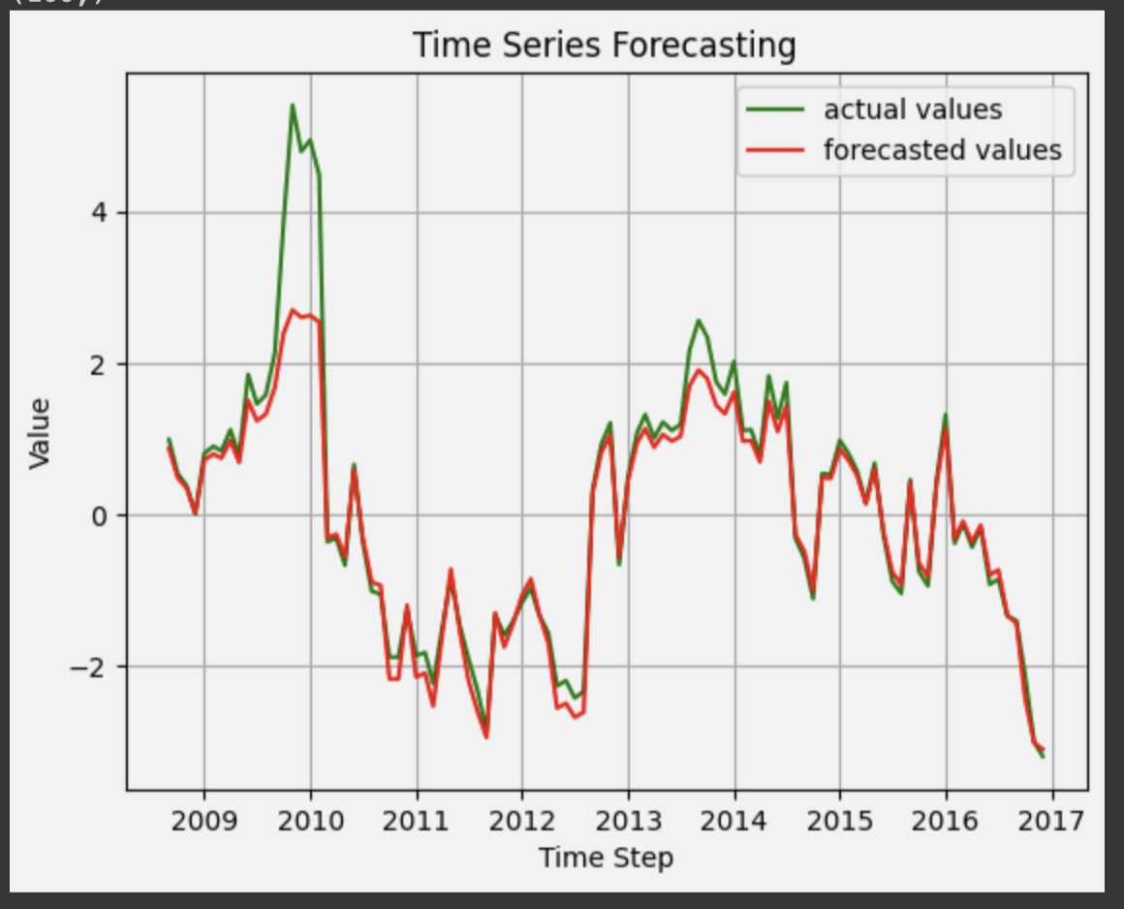
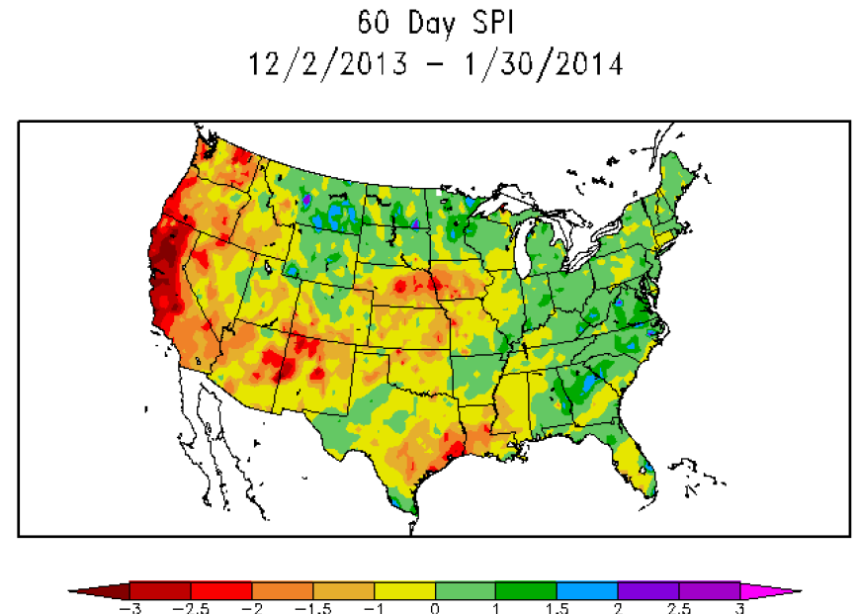
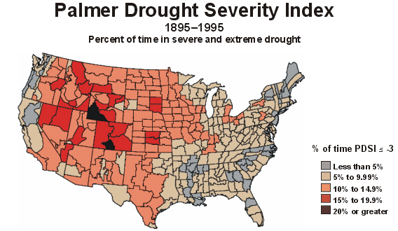
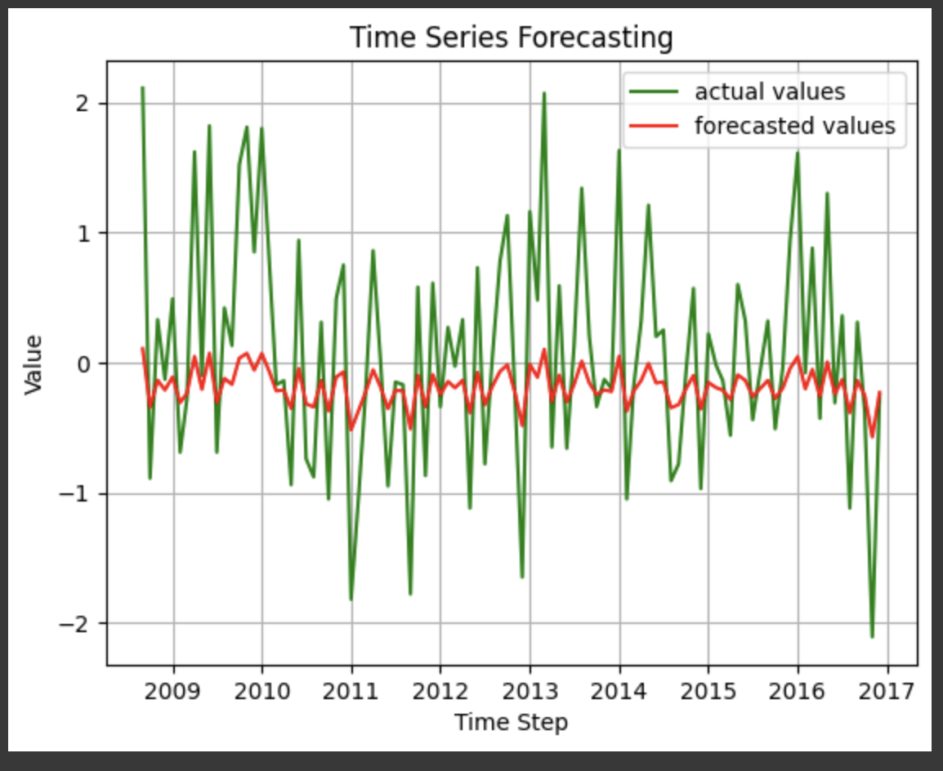
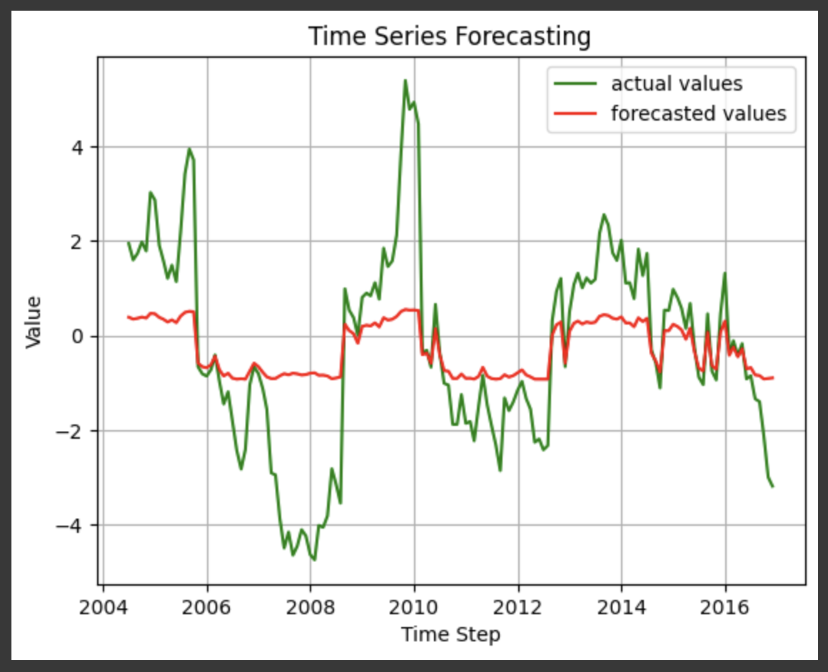
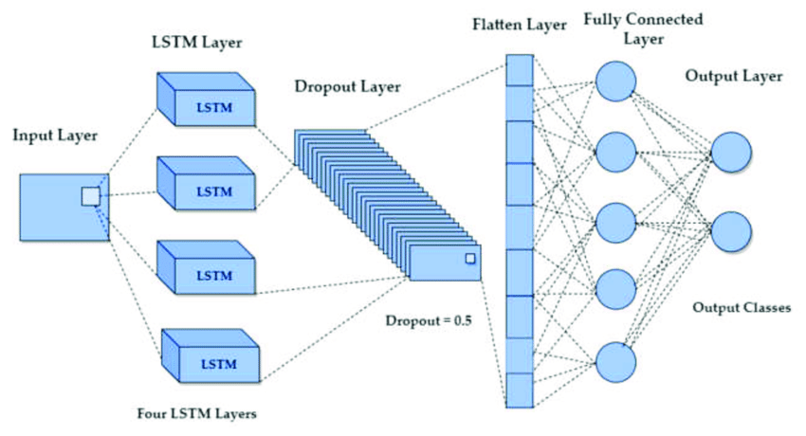
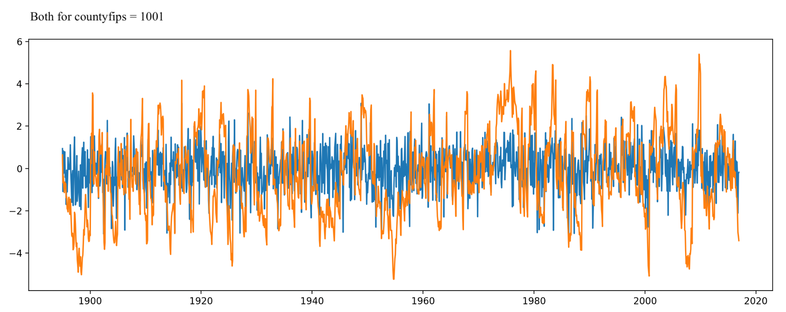
Drought Prediction
Motivation
MSE Loss for PDSI
Shamika Dhuri
Baseline Model
Drought is increasingly becoming a problem for farmers in the recent years. As you can see from this chart, the level of drought in the US over the past 20 years has significantly increased. Without water, agriculture suffers and farmers are unable to produce enough food to financially provide for themselves and to provide for the nation’s food needs. Because of this, drought prevention and methods for dealing with drought are heavily researched. Farmers can choose drought resistant crops, change their growing season slightly, or create more climate controlled environments to grow in.
The figure above shows the mean squared error loss for some of the models trained for PDSI prediction. As can be seen, the loss after adding a scheduler and extra layers to the LSTM was significantly lower.
The baseline model that was implemented, a 2 layer LSTM, gave fairly accurate predictions over a short time period, as is shown above. Training was done on the first portion of the data and the model predicted the last time points. The predictions were compared to the real data at the end of the time series.
MSE Loss for SPI
Though drought prevention and resistant measures are available, without knowing when or where a drought will occur, we are unable to put these measures in place early enough for them to be useful. The solution here is predicting drought using environmental metrics so that measures can be taken before a drought occurs.
In previous literature, it seems as though often, Machine learning methods were used on isolated datasets where only one metric was used to predict drought.
However, several different metrics exist. They are just not being used by the same models.
PDSI prediction
Data
The figure above shows the mean squared error loss for some of the models trained for SPI prediction. Unfortunately, it seemed like the only thing that would decrease the loss for SPI was increasing the amount of history that the model took in at each training instance. This might be because SPI data has more variability as the precipitation is not the same day to day. This means that it is difficult for the model to learn patterns in the data.
From left to right are figures showing the performance of the baseline and my improved model when predicting PDSI data for a long period of time. As you can see in my improved model predictions are more accurate (the lines are generally closer matched). As you might notice, high values are not as accurately predicted. This is not a concern as predicting high likelihood of no drought is not the main focus. Predicting drought (low PDSI) is.
SPI prediction
Model Architecture
The two datasets that I used are the Standardized Precipitation Index (SPI) and the Palmer Drought Severity Index (PDSI). Both are made available by the US government and cover the years from 1895 to 2016
Represented as time series data, the above figure shows how the PDSI data (orange) and SPI data (blue) for the county with the ID 1001 look when plotted over the time period given by the dataset. High PDSI and SPI values indicate that there is not likely to be a drought in the area while low numbers indicate that there is likely to be a drought. As can be seen, PDSI data is smoother and has less variation over short time frames.
From left to right are figures showing the improved model performance when predicting SPI data and when predicting PDSI data when trained on both datasets. As you can see, adding SPI data made the model significantly worse. This is likely because SPI data varies more that PDSI data because it is tracked more frequently and is more likely to pick up noise. Predicting an average reduces the model’s loss more than trying to accurately fit the SPI data.
The figure above shows the final model architecture that performed the best for PDSI prediction.

